Slide 1

Sea Turtle Protection Program 2025 Annual Report Summary

Slide 2
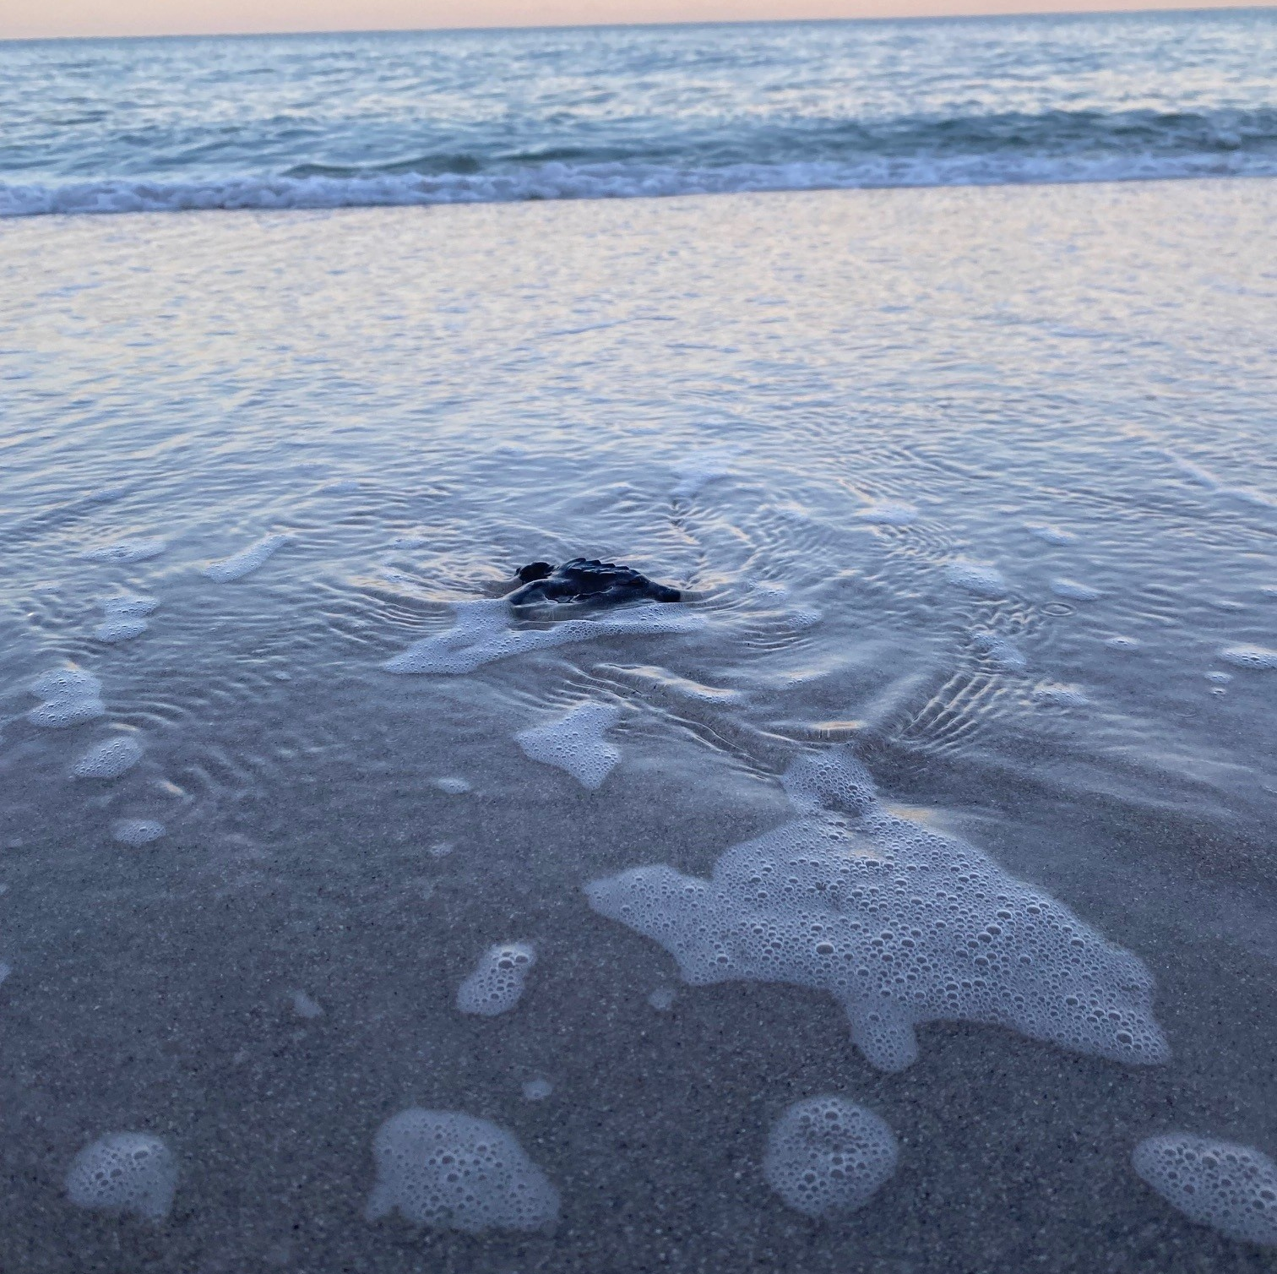

Program Overview & Priorities
Protect and monitor
Protect and monitor sea turtle nesting activity
Fulfill
Fulfill beach renourishment permit requirements
Coordinate
Coordinate with Florida Fish and Wildlife Conservation Commission for stranding efforts across the County

Slide 3
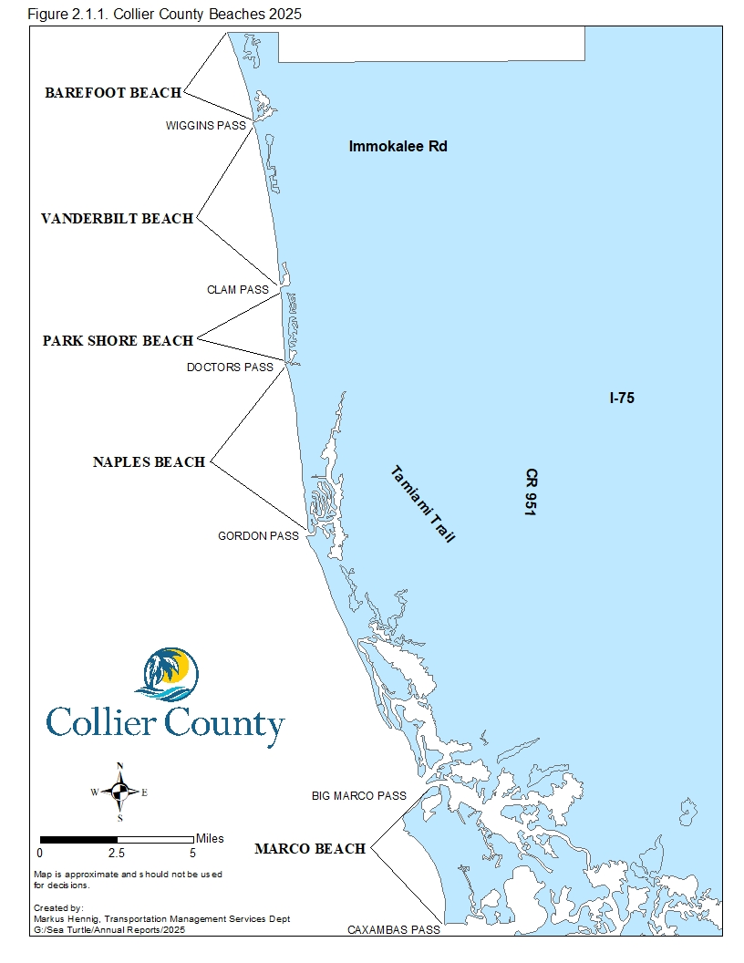
Study Area
• Barefoot Beach
• Vanderbilt Beach
• Park Shore Beach
• City of Naples Beach
• City of Marco Island Beach
22.5 miles of surveyed beach

Slide 4
Nesting Activity
The 2025 sea turtle nesting season was one of the most successful on record for Collier County
Data collection took place from April 15 through October 31
1,179 nests were documented
1,285 false crawls (non-nesting attempts) were recorded
86,565 hatchlings are estimated to have safely reached the Gulf of America

Slide 5
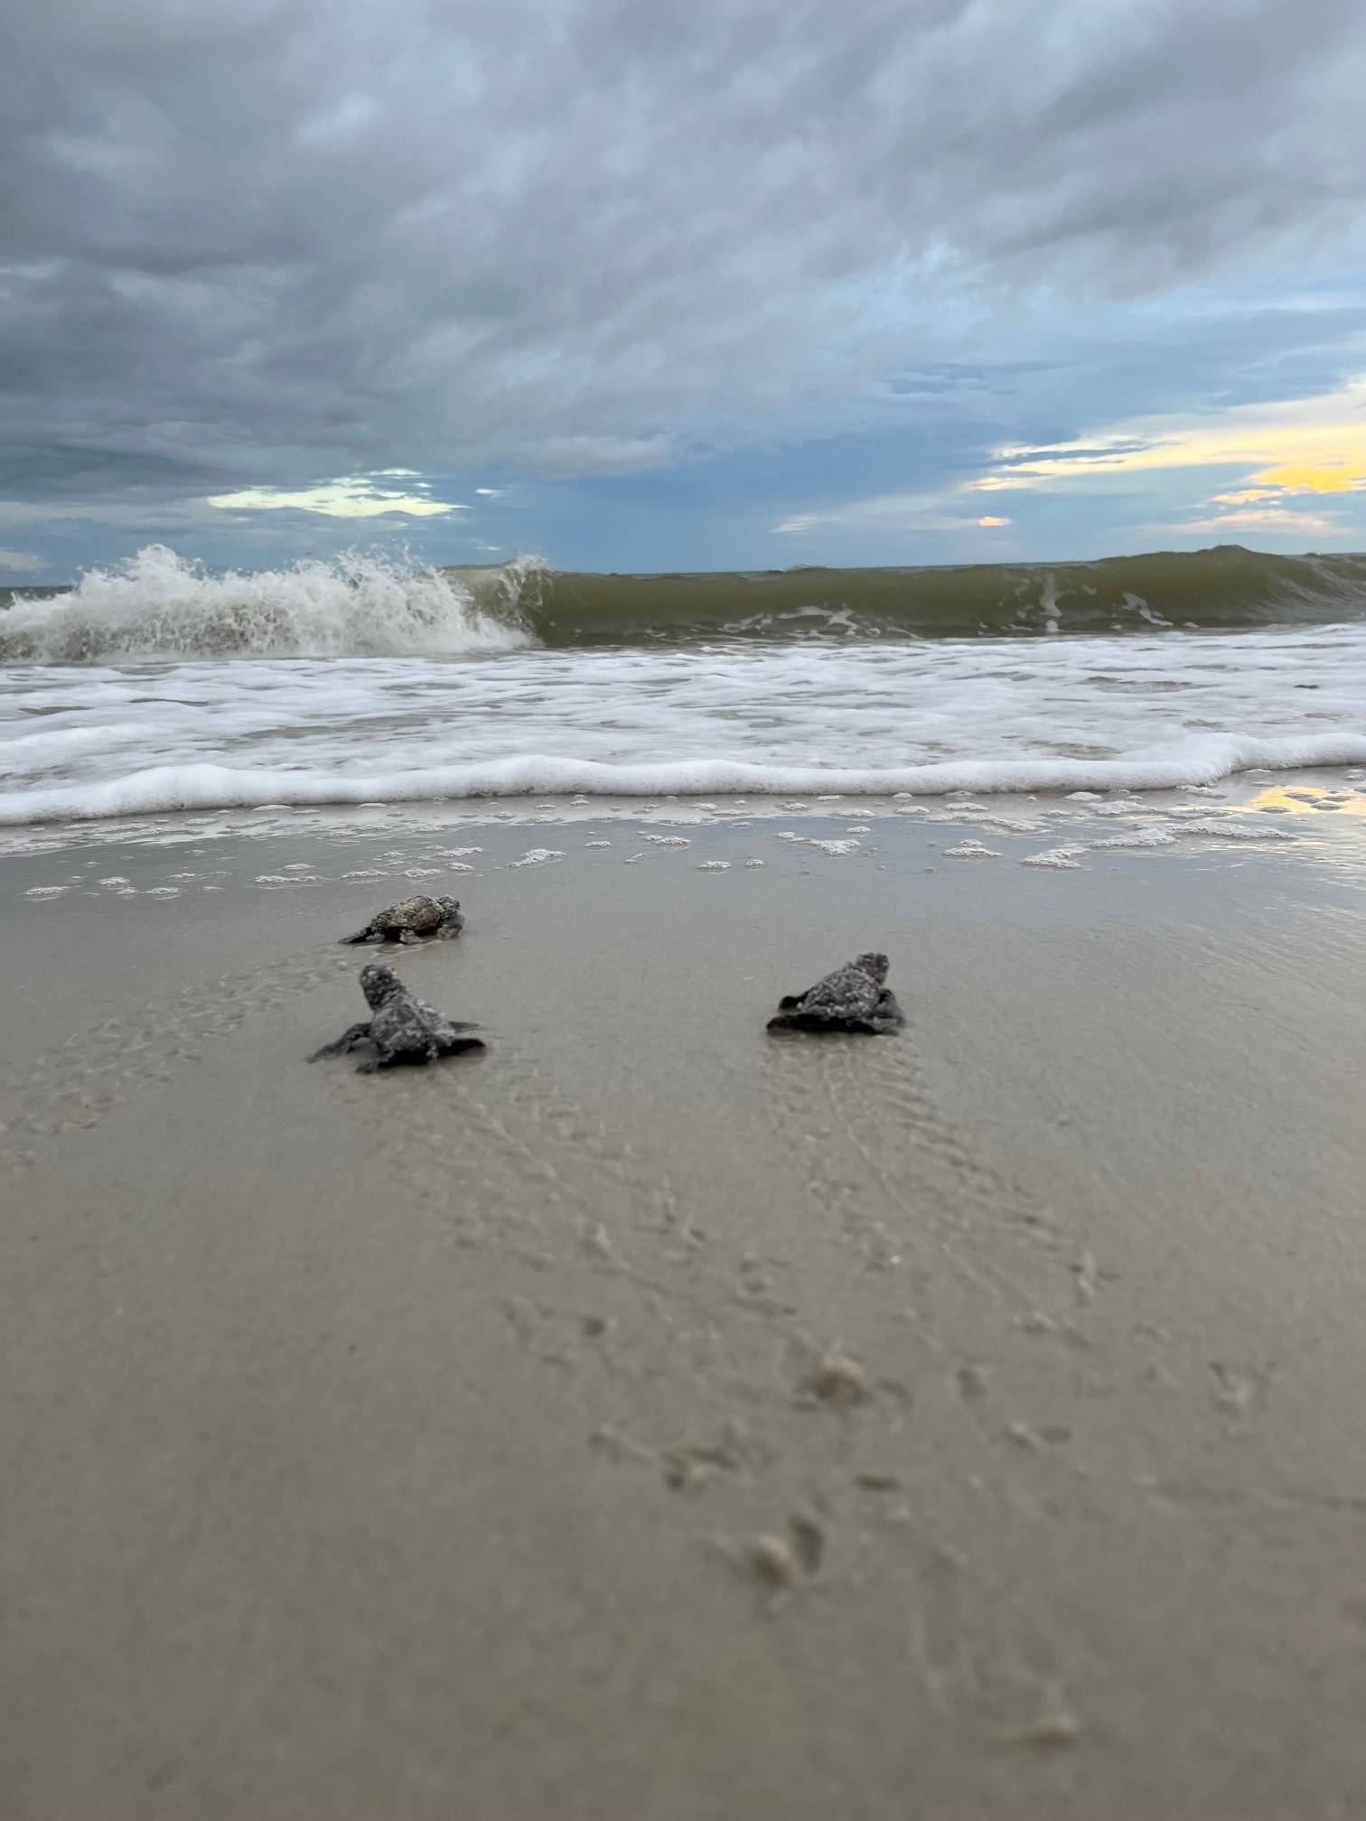
2025 Season Highlights
Diversity
25 green sea turtle nests were recorded
The highest amount since the program’s inception in 1994.
1 leatherback sea turtle nest
The second leatherback emergence since 1994 the only documented nest on the entire West coast of Florida.
Hatchling Success
Overall hatch success averaged over 80% across beaches, one of the highest rates in the last 5 years.

Slide 6
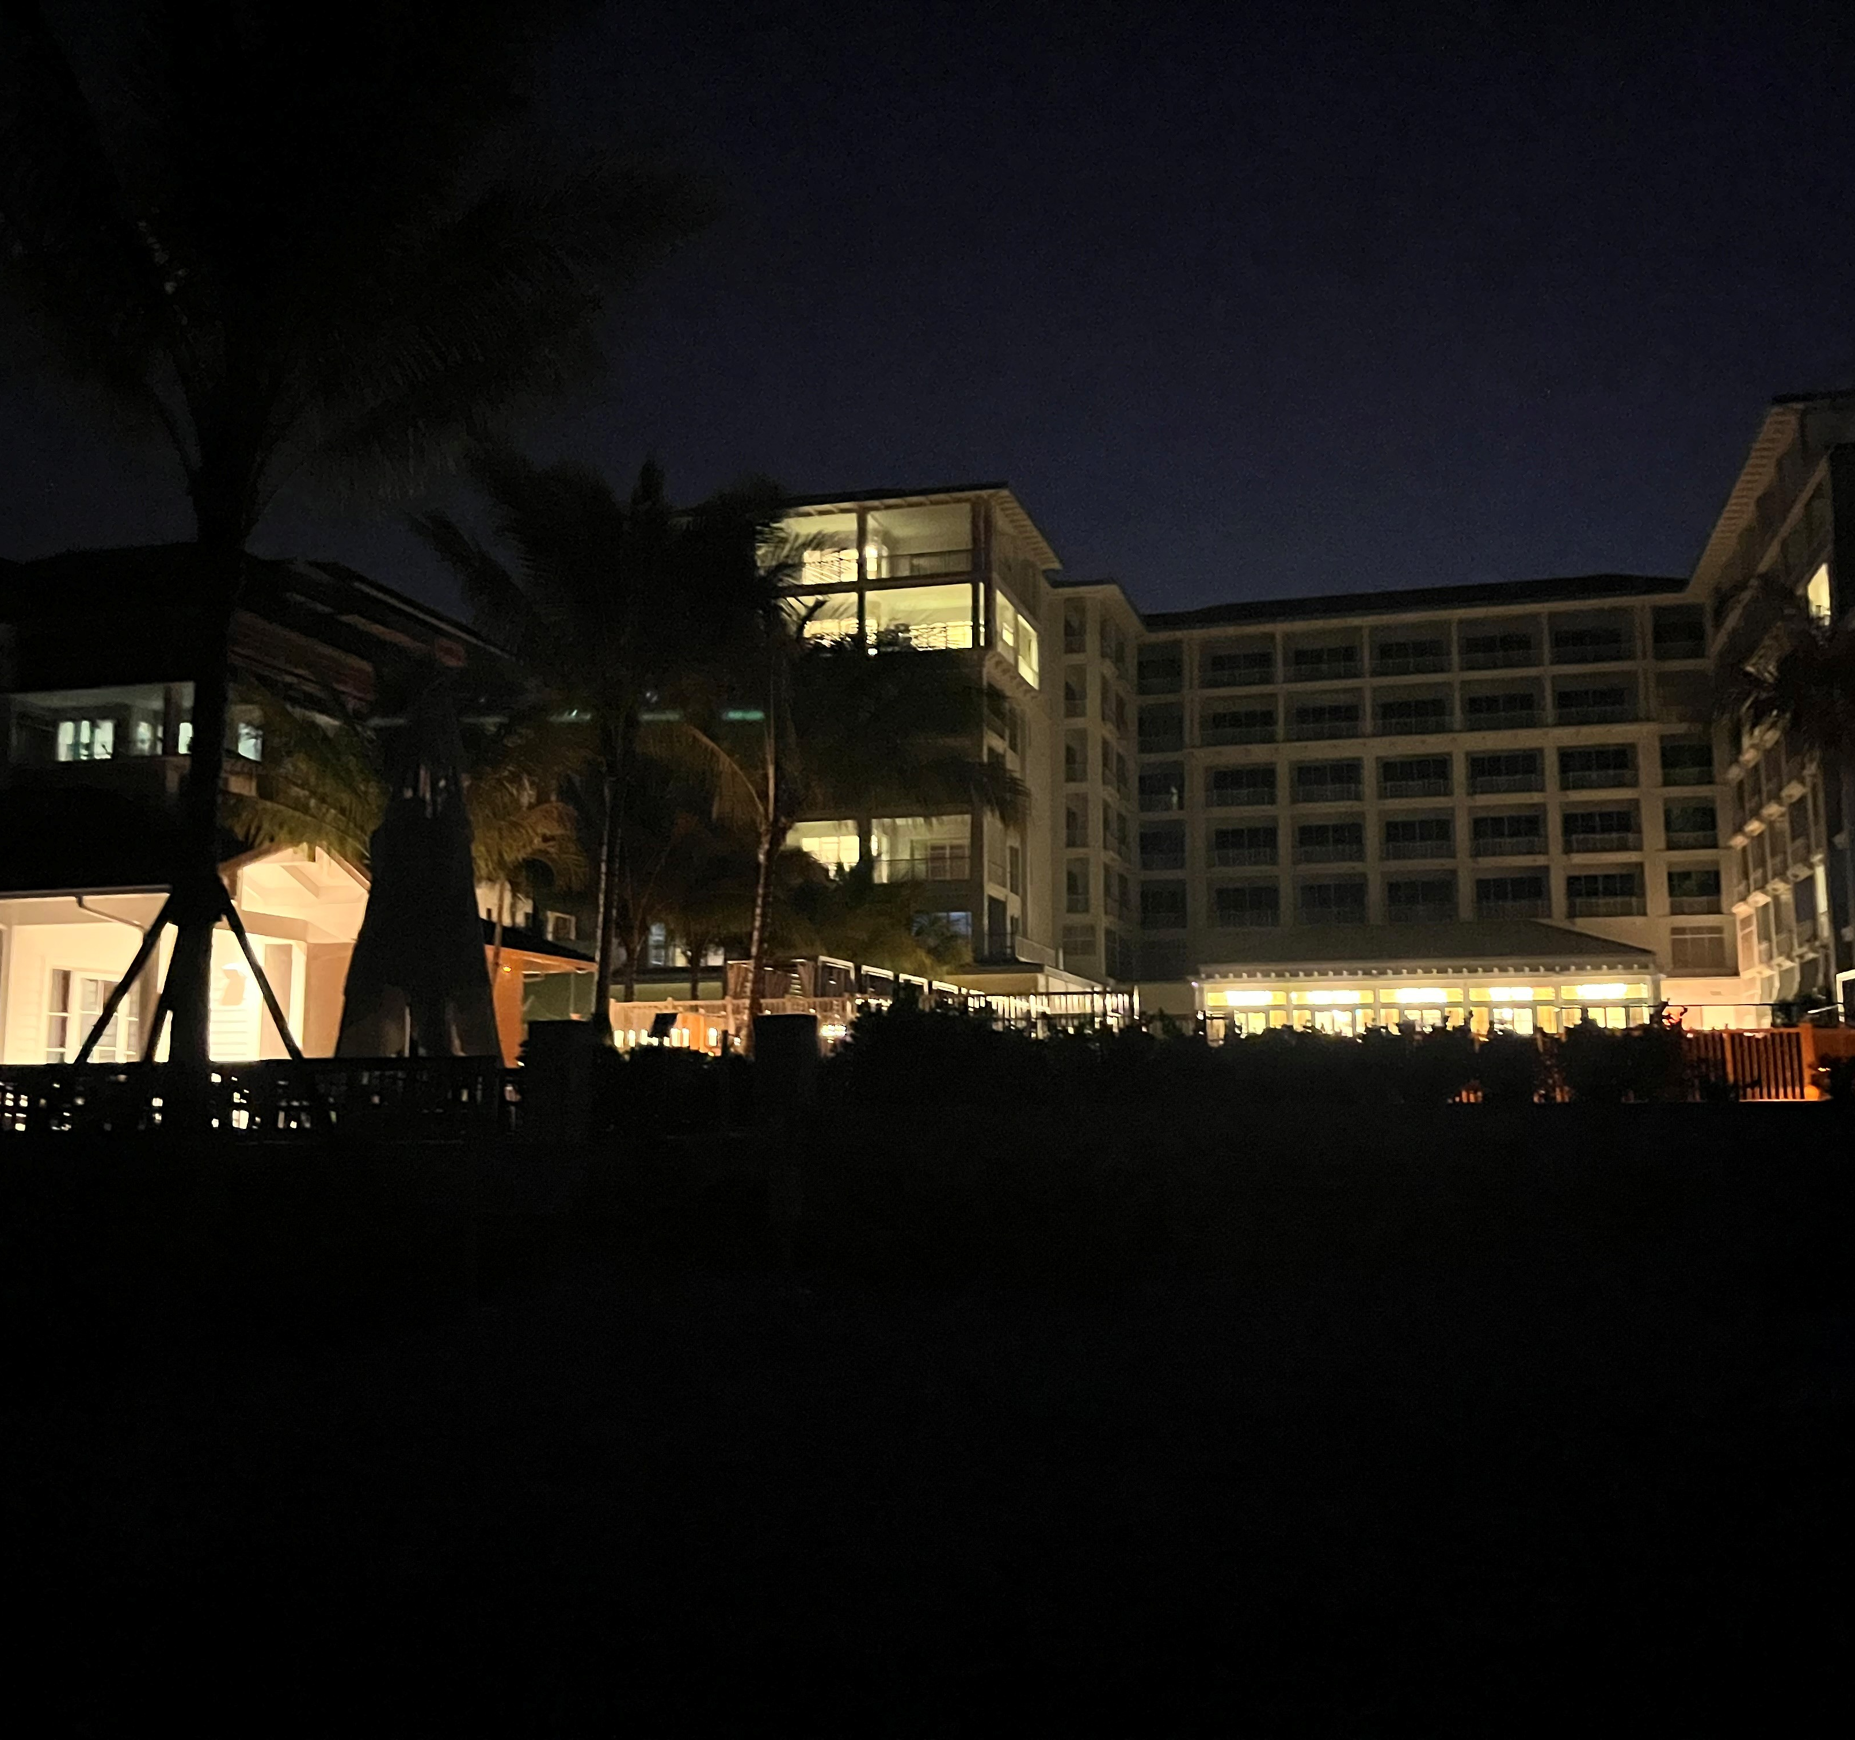
Leading Threats to Our Turtles
Artificial beachfront lighting remains the single greatest human related threat to our hatchlings.
Hatchlings often crawl toward artificial light instead of the Gulf (disorient), leading to exhaustion, dehydration, predation and automobile encounters
16% of hatched nests disoriented during the 2025 season

Slide 7
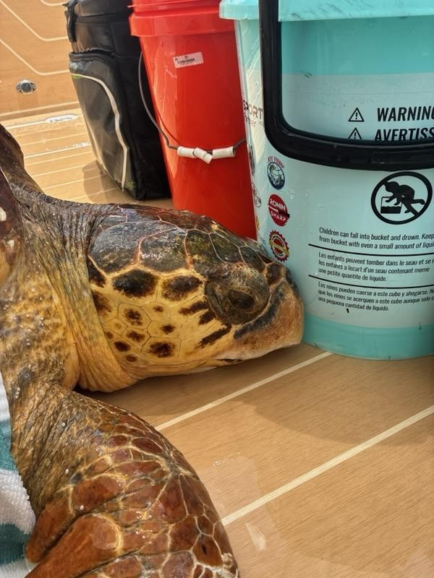
Stranding and Recovery
The Sea Turtle staff responded to 21 sea turtle strandings in 2025.
14 dead (12 loggerheads, 2 greens)
7 live (rehabilitated)
Common causes:
Boat strikes
Fishing gear entanglement
Predator bites
Public reporting plays a critical role in successful rescue and response efforts.
Report a turtle in distress by calling (239)285-7760.

Slide 8
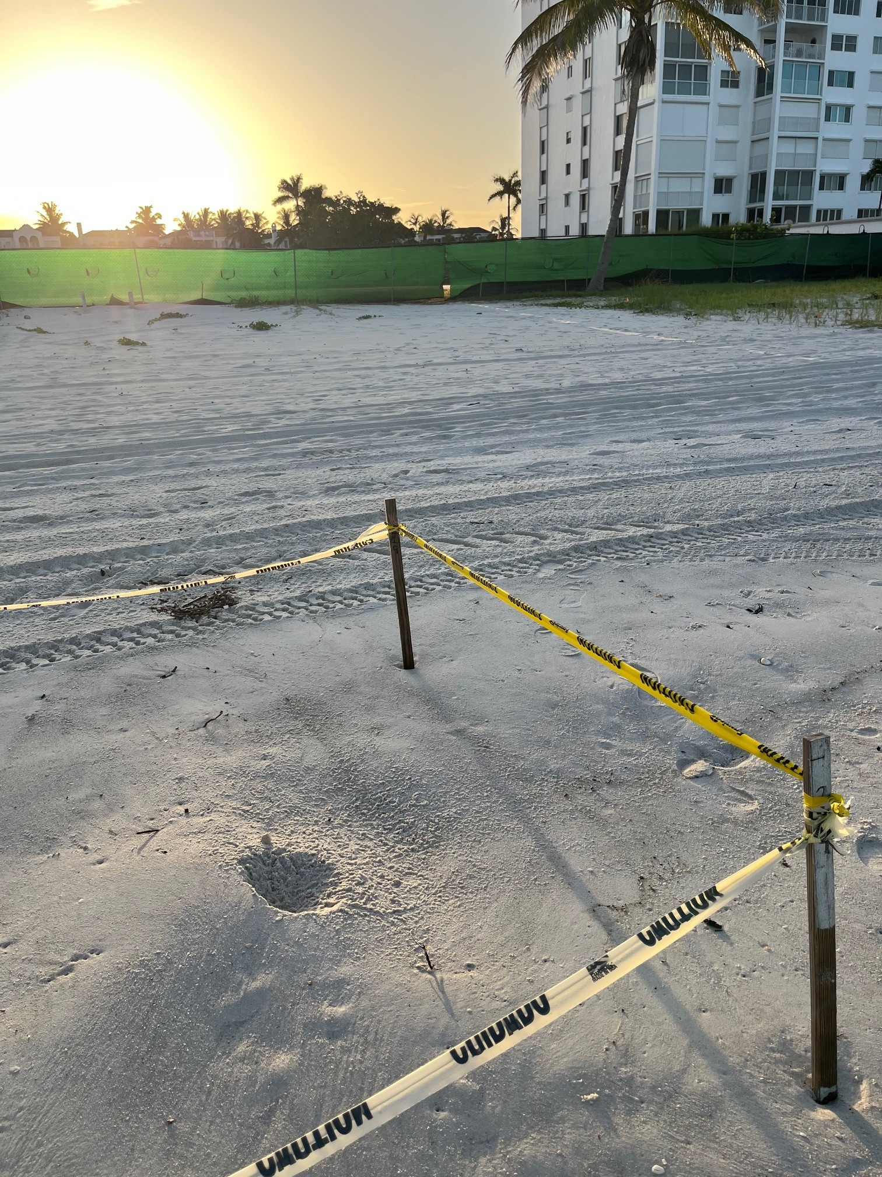
What You Can Do
Residents and visitors can help protect sea turtles by:
Turning off or shielding beachfront lights at night
Removing beach furniture and equipment each evening
Filling in holes and knocking down sandcastles
Keeping beaches clean and free of debris
Reporting stranded turtles to authorities
Small actions make a meaningful difference!

Slide 9
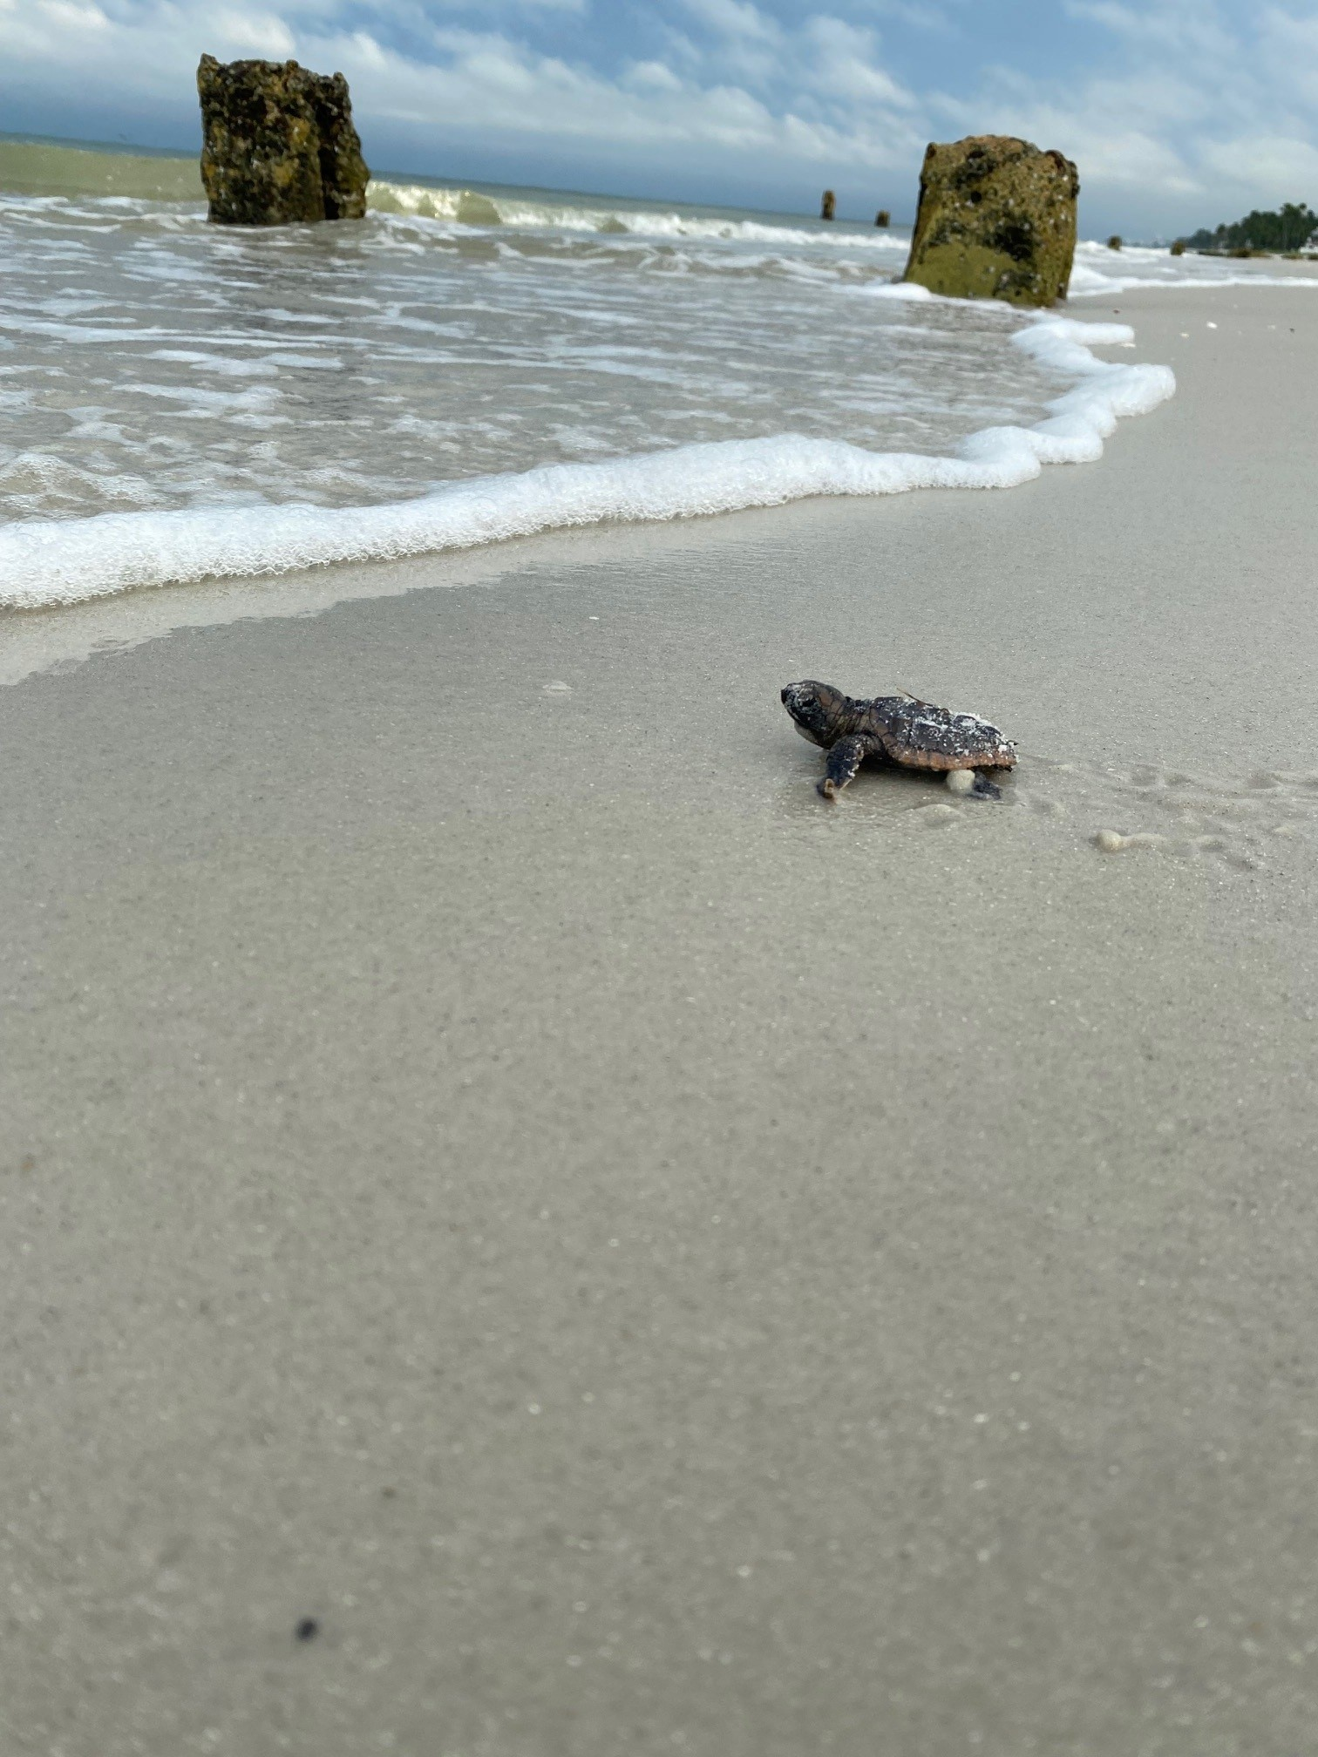
Looking Ahead
Collier County remains committed to proactively protecting sea turtles while maintaining safe and accessible beaches for the public
With continued community involvement, and strong state protections, the outlook is promising for these treasured animals that call our beaches home

Slide 10
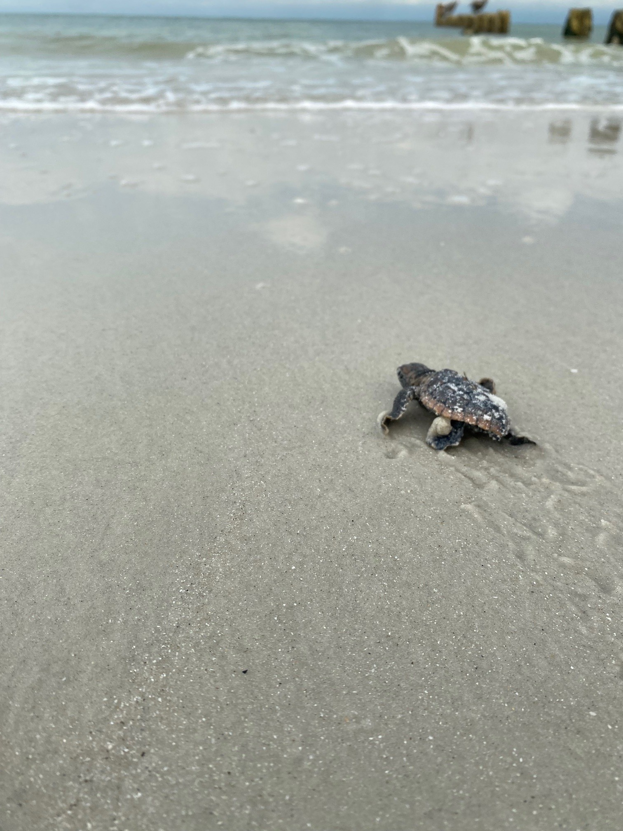
Questions or Concerns?
For a more detailed look at the data comprising the 2025 season click on the link: Link to Full Report
Feel free to reach out with any questions: mary.toro@collier.gov or 239.252.2955

