Slide 1
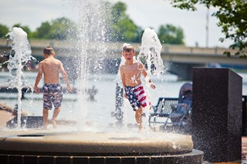

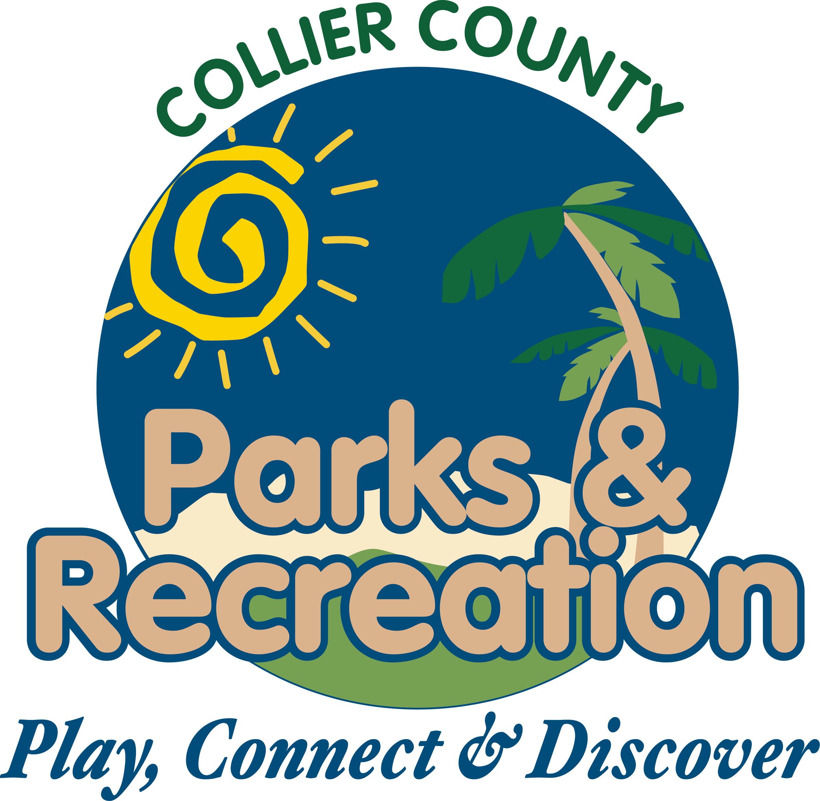
Big Corkscrew Island Park
Public Workshop
Collier County Public Services Division
August 27, 2015

Slide 2
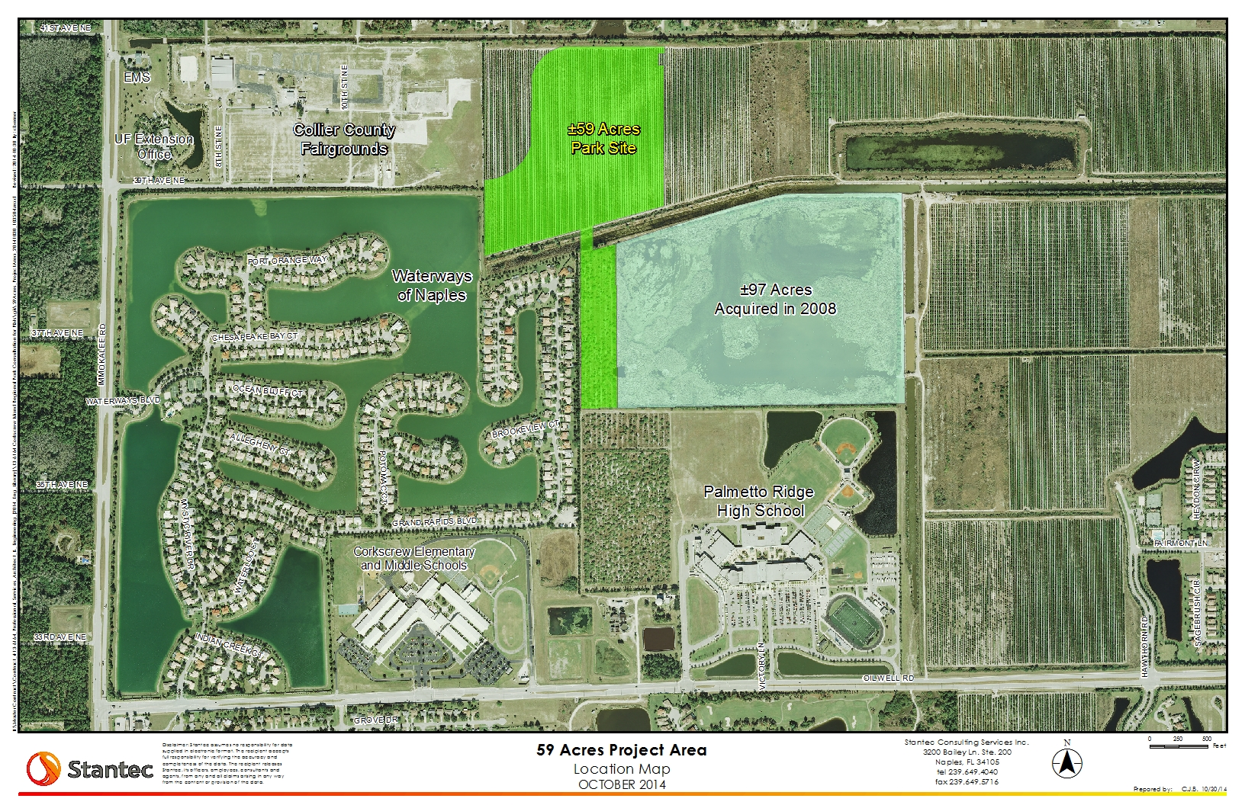
Park Location

Slide 3
Master Planning – What is it?
To develop or improve (land, a community, a building complex, or the like) through a long-range plan that balances and harmonizes all elements
Key elements:
Land
Environment
Water Management
Uses (elements – the fun stuff!)
A Master Plan is a Living, Breathing Work…

Slide 4
Master Planning
How do we do it?
Identify constraints and opportunities
Land
How much do we have?
±156 – 160 acres to start with
Environment
Wetlands?
Species?
Mitigation costs?

Slide 5
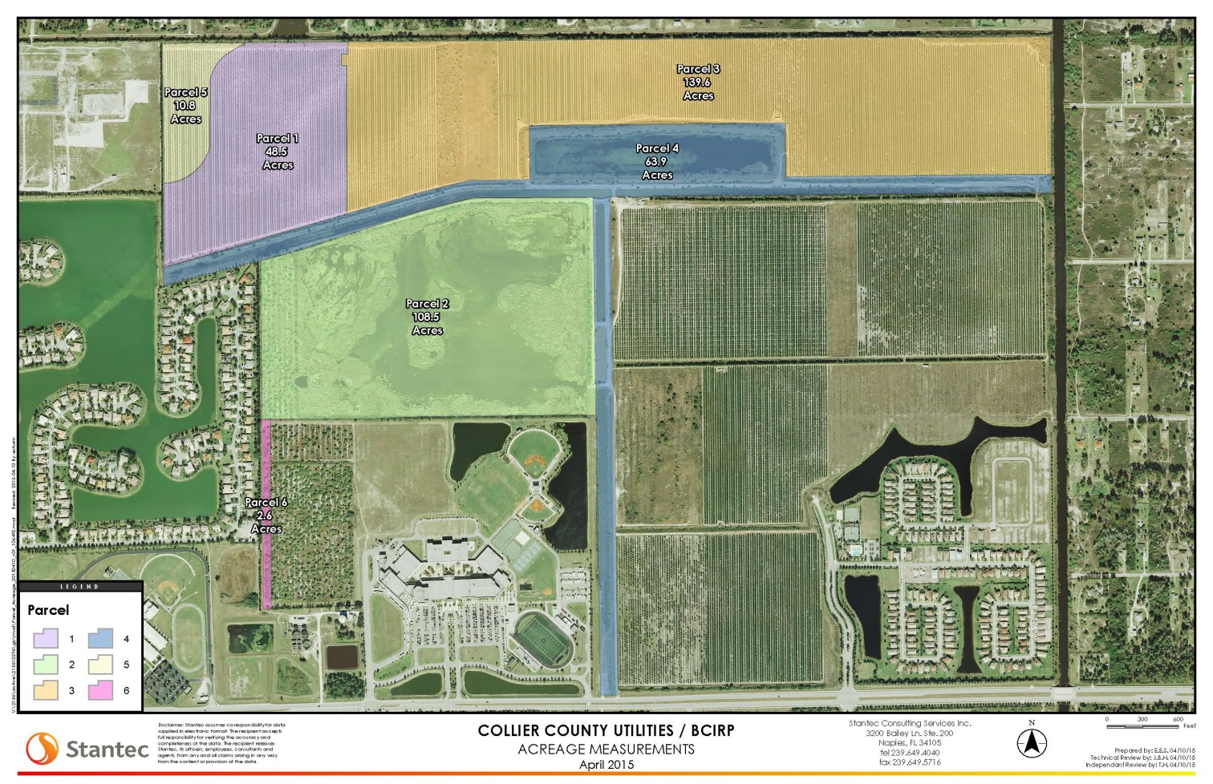
Water Management Opportunities and Constraints…
Canals
-Part of WM system of OBR and Waterways
-Can we use it and not impact WW and OBR?
97 acre Lake
-Uses and rights:
-Used for OBR WM
-Water Rights for Ag
-Will a new, smaller lake work?

Slide 6
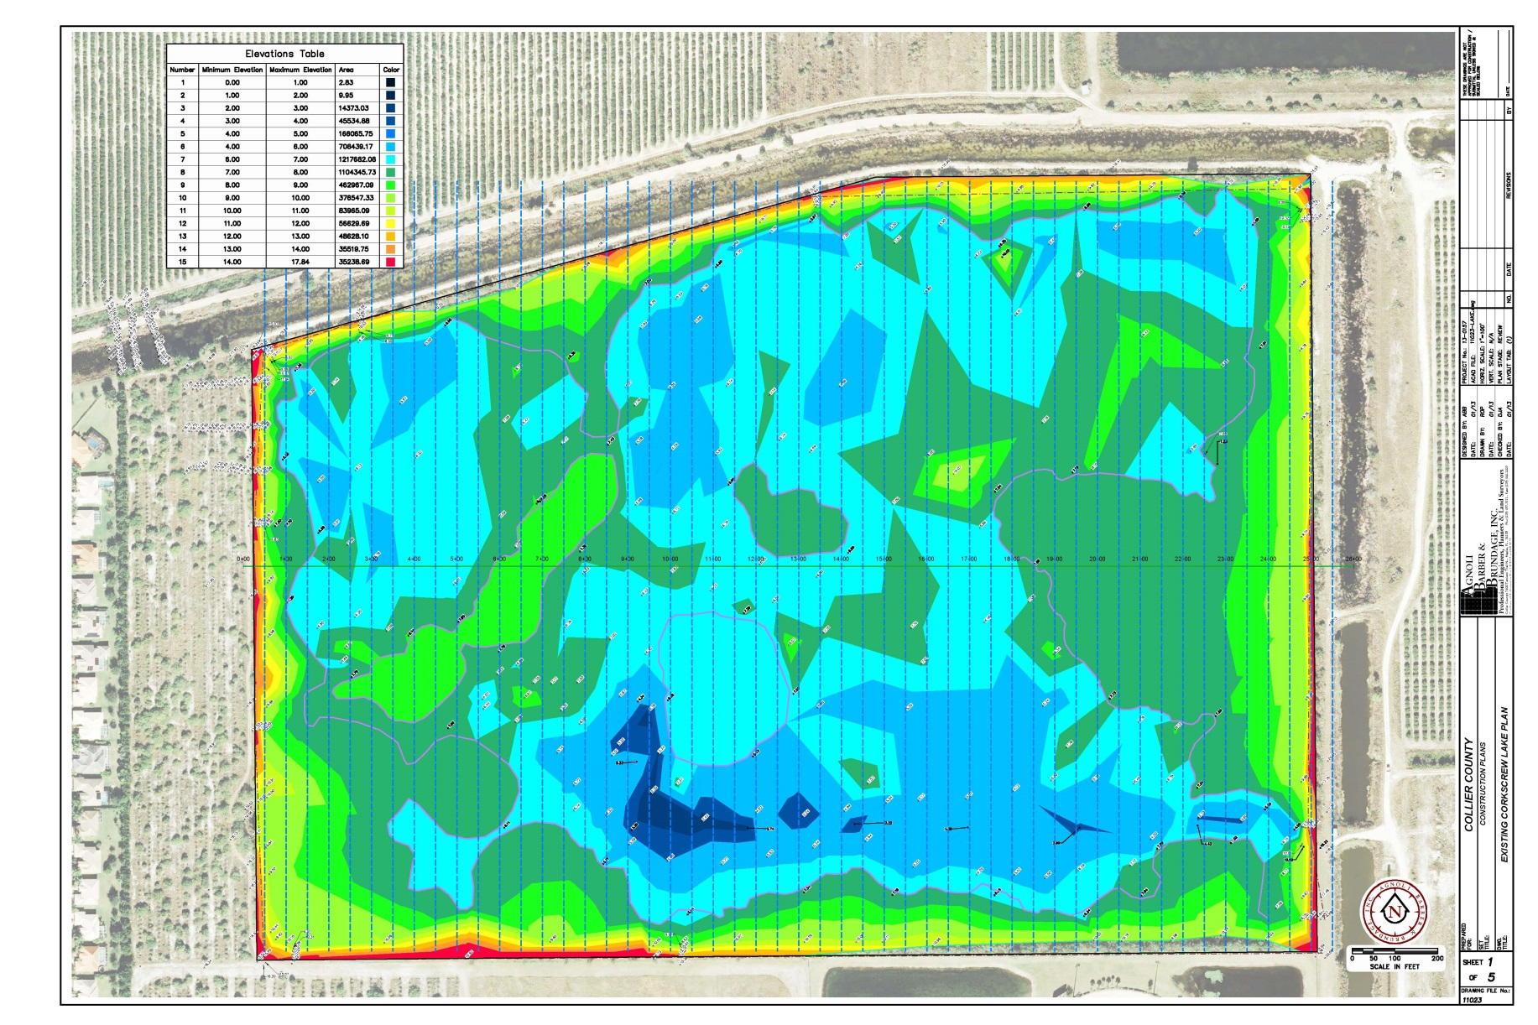
How deep is the Lake?

Slide 7
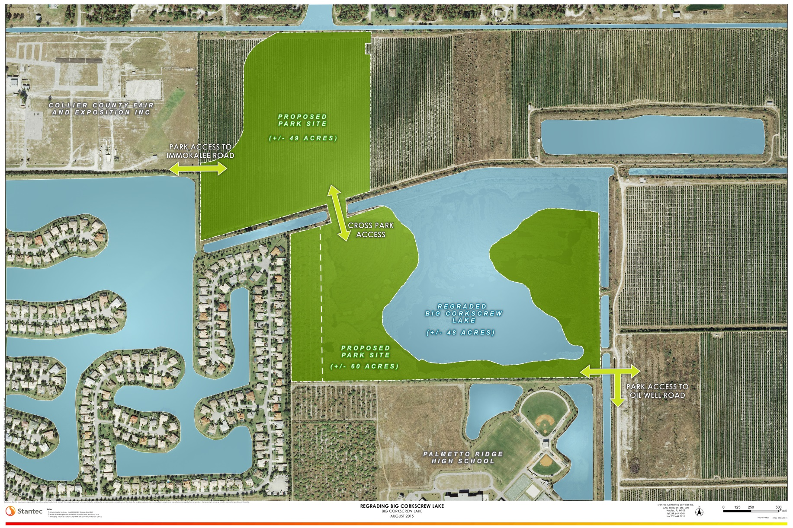
Possible Lake Arrangement

Slide 8
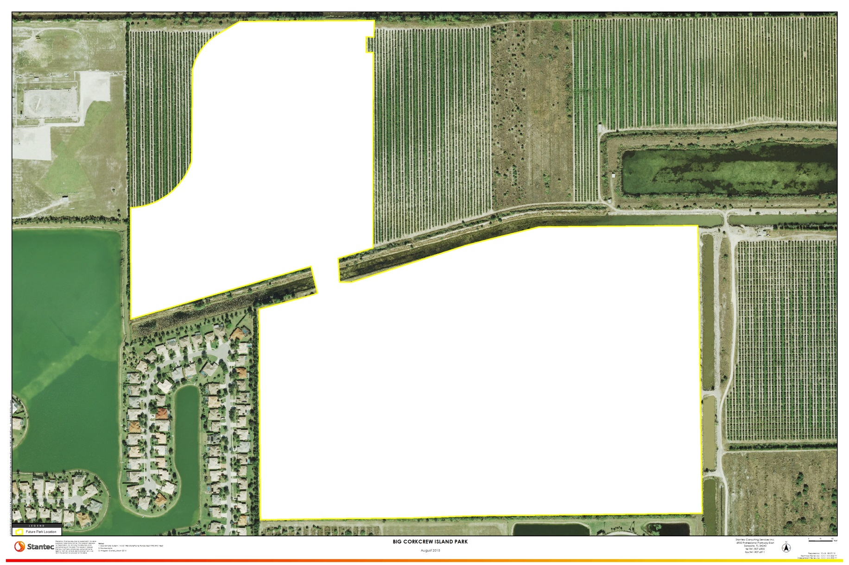
Big Corkscrew Park Plans!

Slide 9
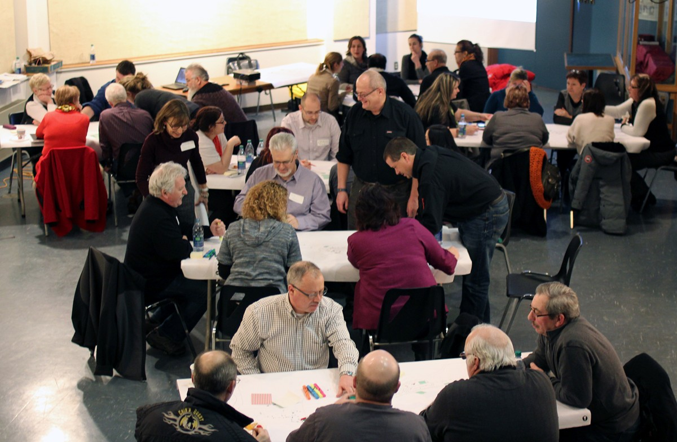
Tonight’s objectives:
Groups working together will develop lists of uses and design ideas
We will be there to help, guide and answer questions
Planning tools will be provided
THIS IS YOUR PARK, YOU GET TO DESIGN IT!!

Slide 10
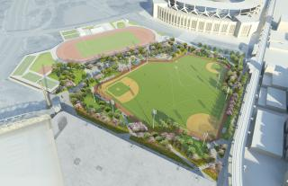
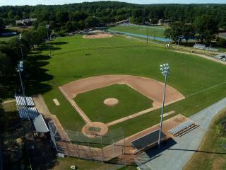
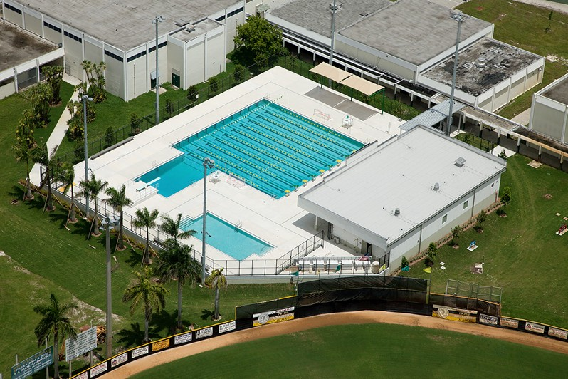
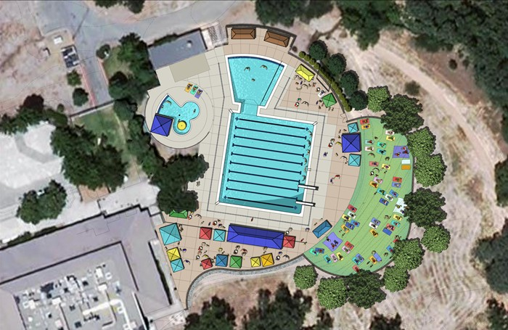
Ideas? They are all good!!

Slide 11
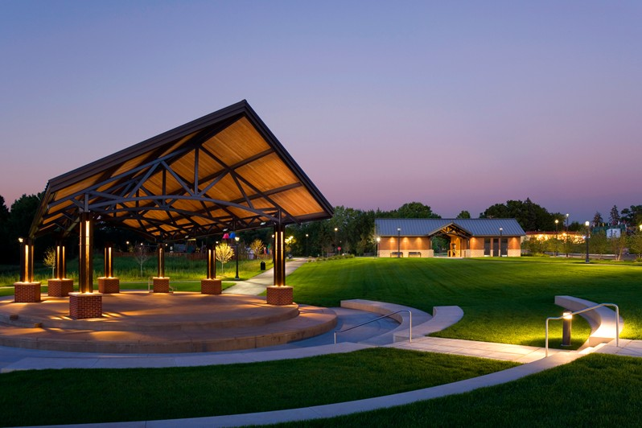
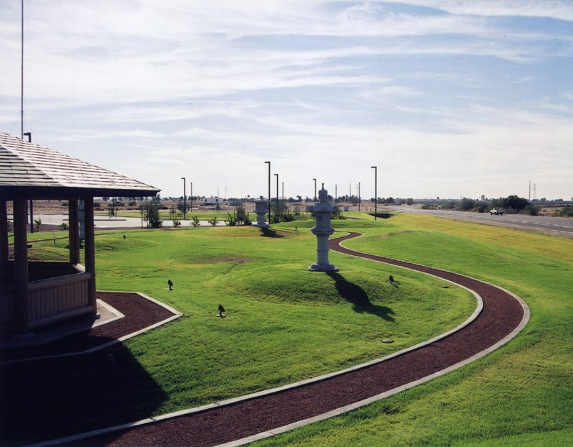
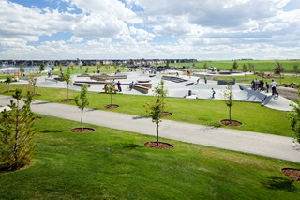
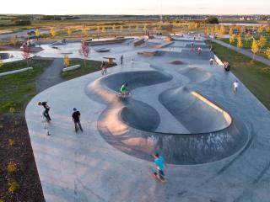
Think outside the box…

Slide 12
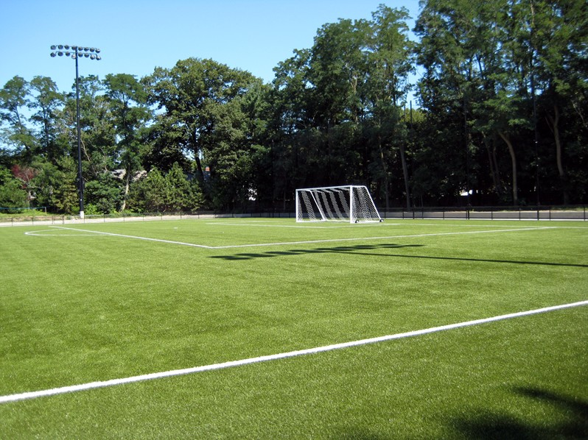
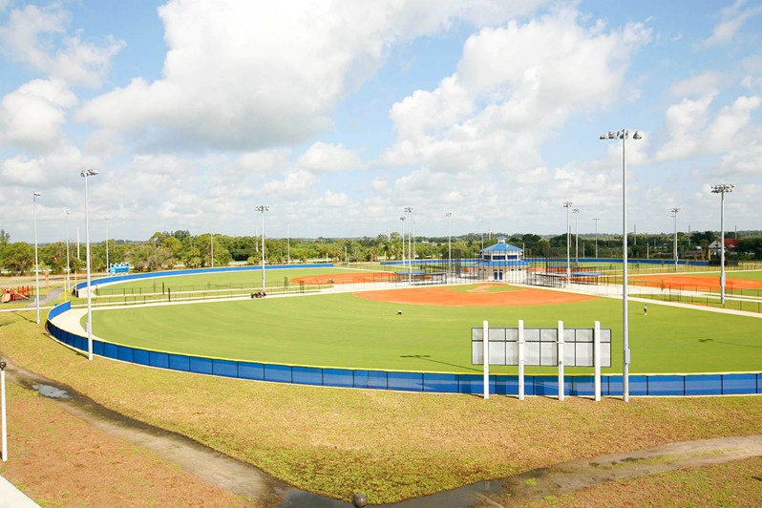
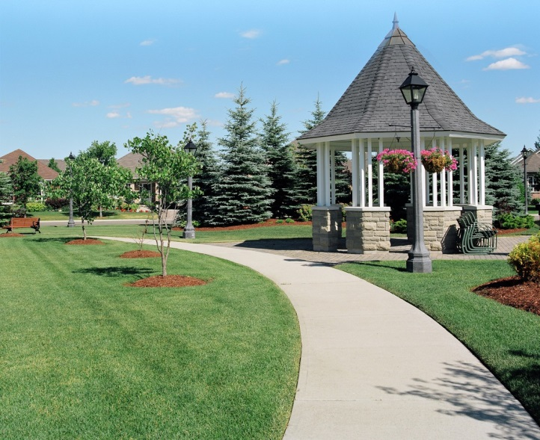
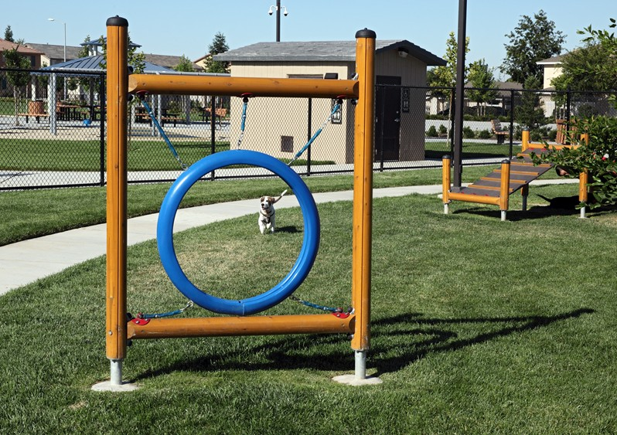
Green is good…

Slide 13
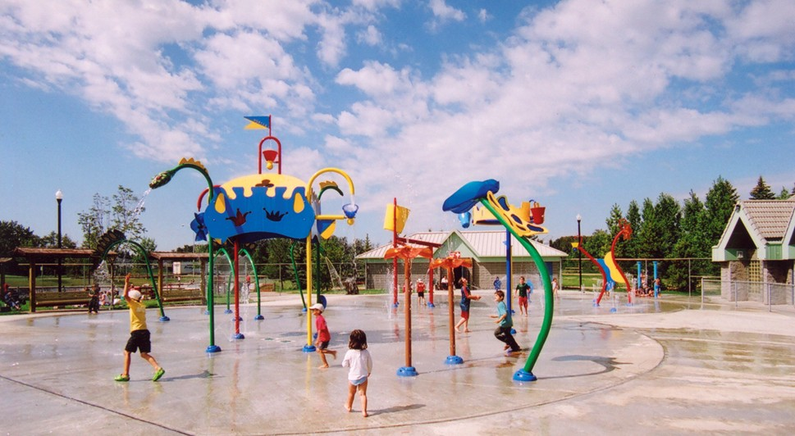
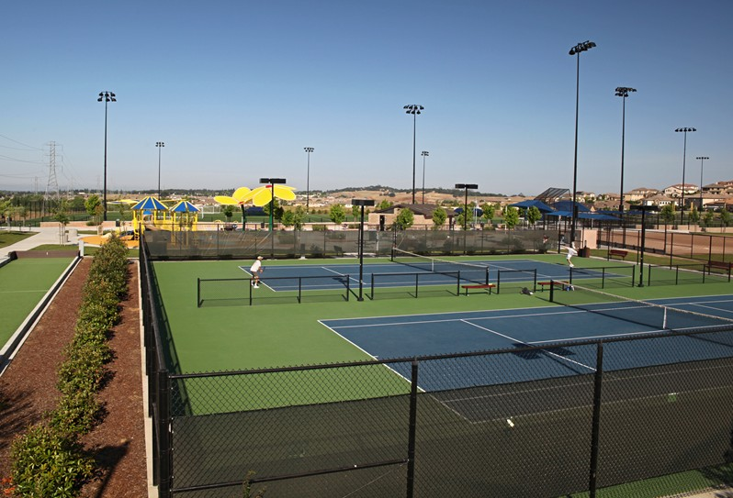
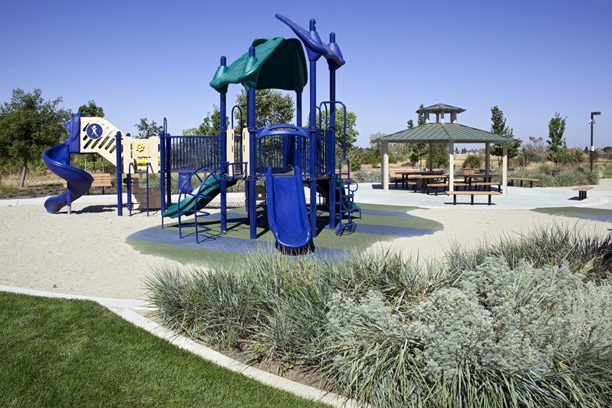

Something for everyone…
What will you create?

Slide 14
Let’s get started!!
1. Appoint a ‘SCRIBE’
2. Write down EVERY idea!!
3. 17 minutes to work
4. No negativity!!!!!
5. No hogs allowed!!!!!

Slide 15
Questions?

